Slide 1
Updated Agricultural Systems Technology (AGST) Curriculum
LEARN@STATE
Mar 13th 2019
AState.edu
/ArkansasState
@ArkansasState

Slide 2
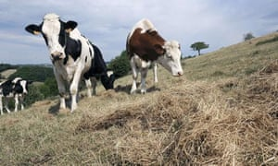
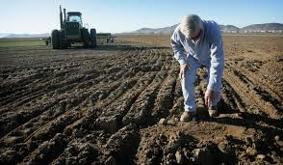
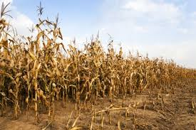
we needed A Change…
Connections between courses: GIS, Remote Sensing, Irrigation
Agro-Environmental Variables: Crop, Soil, Climate, Topography
Process: Understanding data>integrating info with tools
…to solve problems
Notes:
We knew we needed a change, so other than observing what was happening with our students in the classroom we sought the advice of industry partners.
AState Ag. Advisory Board
Greenway
Aquarius
Delta Plastic
Jones Irrigation
Lindsay
Irrigation Mart
Geo Shack
Farmers Edge
Connected Energy
We want to develop skills demanded by the marketplace, such as familiarity with technologies like: GIS, remote sensing, and irrigation planning tools.
So that they can assess elements of the environment which bring variability to agriculture across space and time (soil, climate, and topography).
We seek to construct a foundation in methods of integrate location based data into agronomic decisions, for economic and environmental sustainability.
Analyzing in-field variability and prescribing actions to decrease inputs and increase profit, including understanding variable: nutrient applications, seeding rates, pesticide applications, or choice of crop variety.

Slide 3
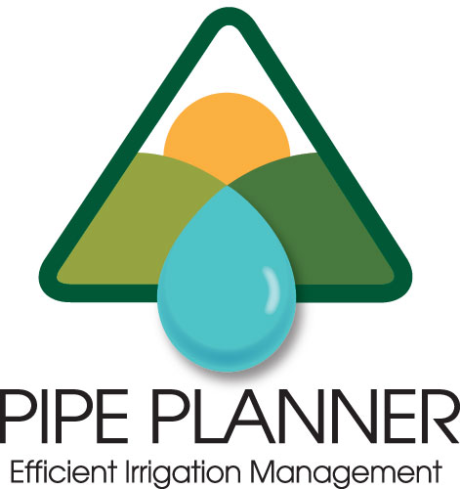
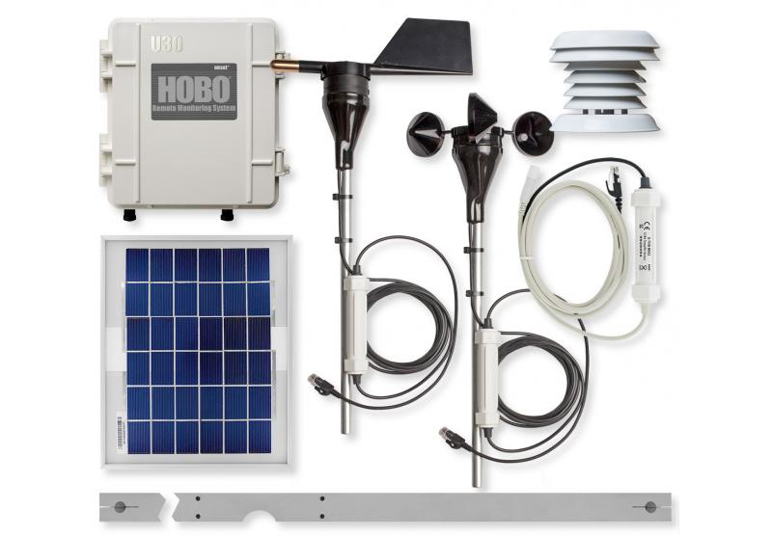
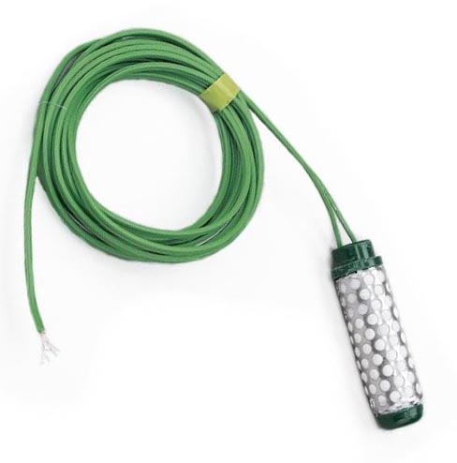
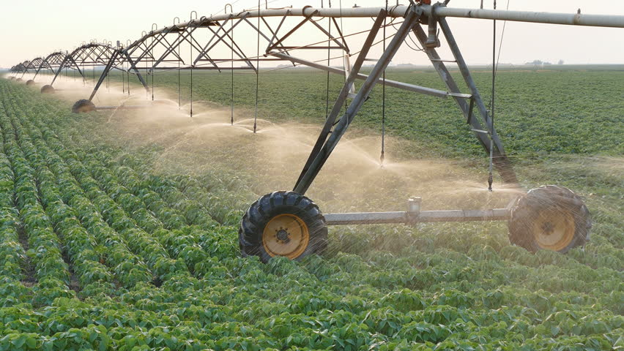
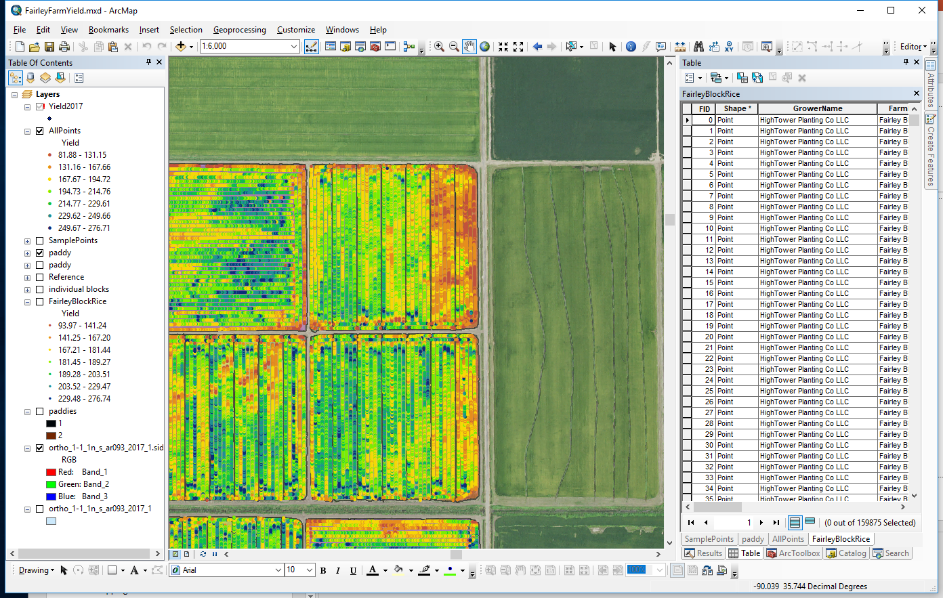
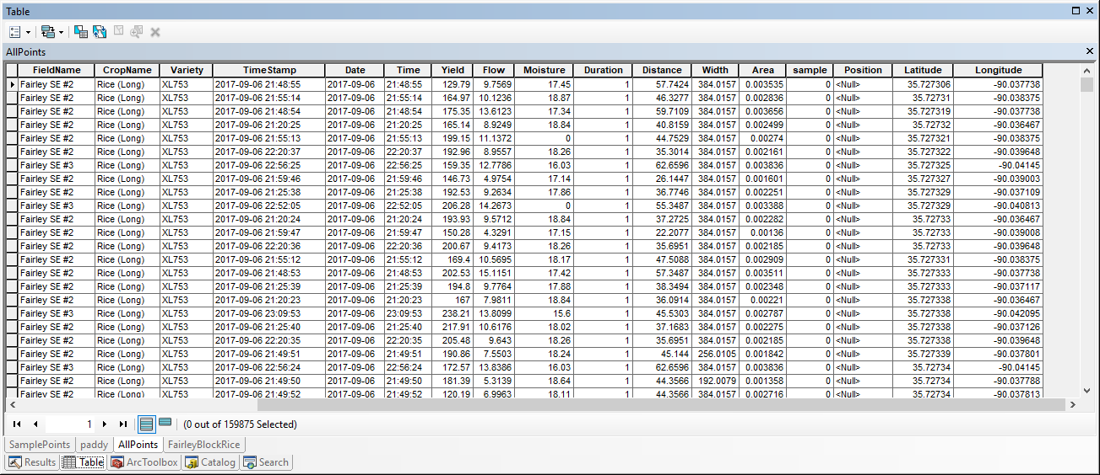
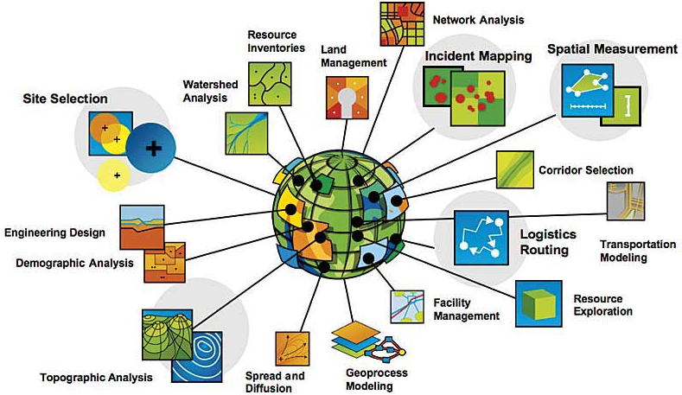
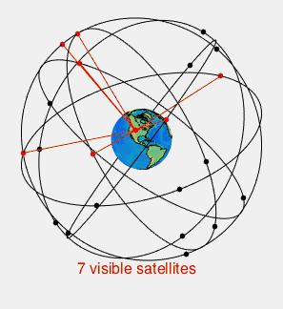
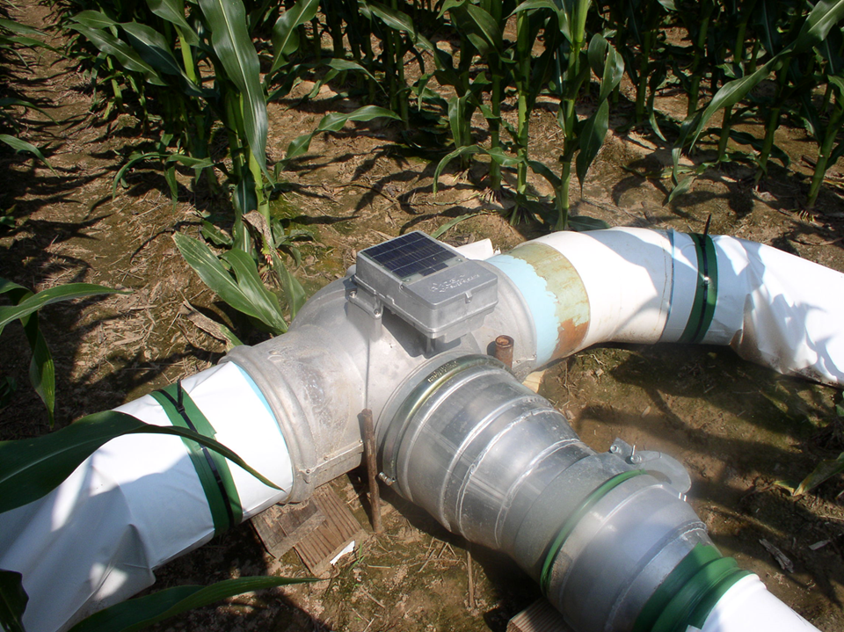
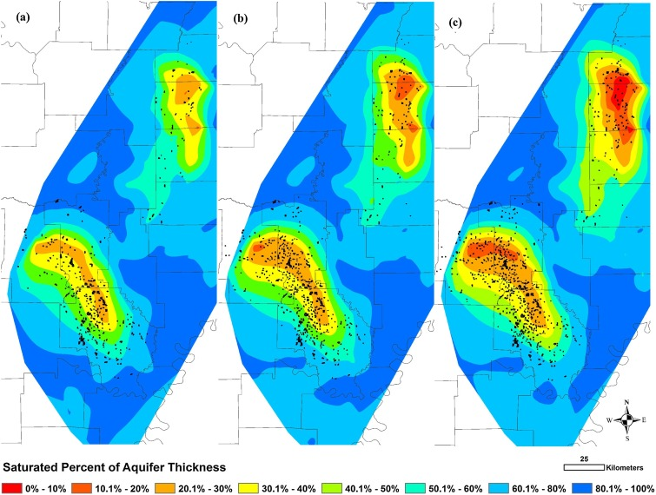
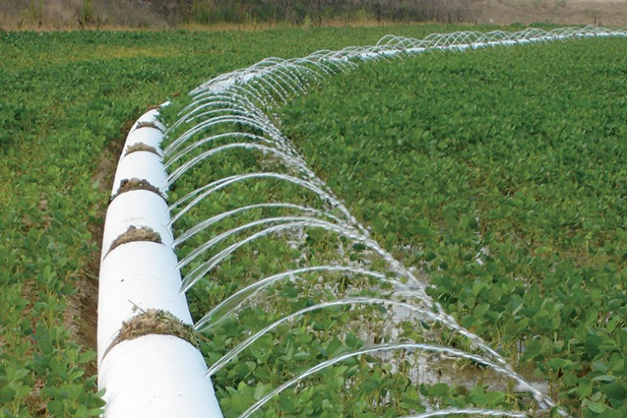
Agricultural Systems Technology (AGST)

Slide 4
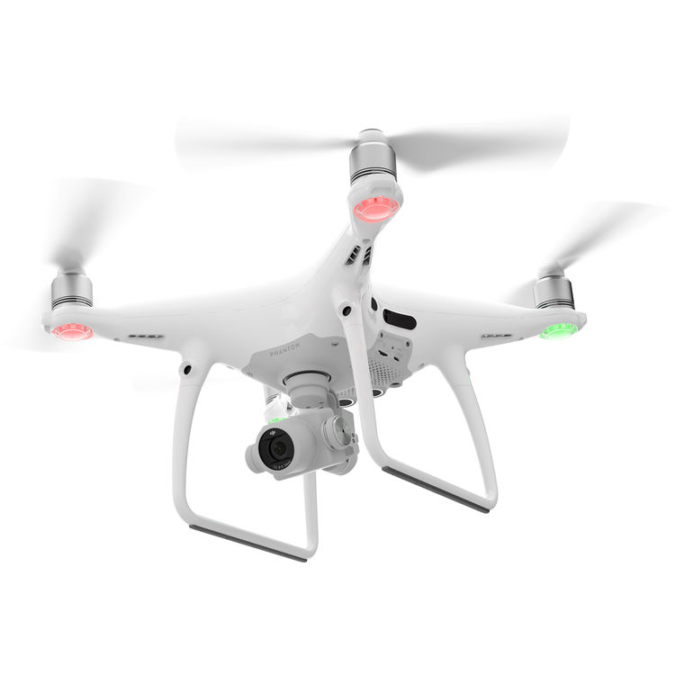
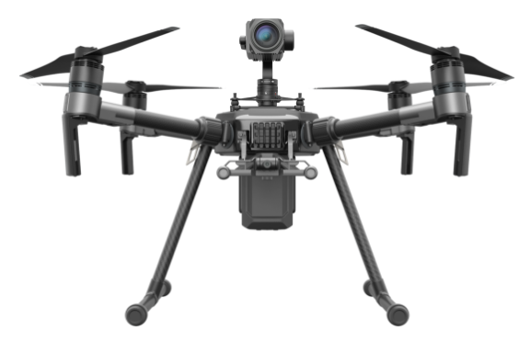
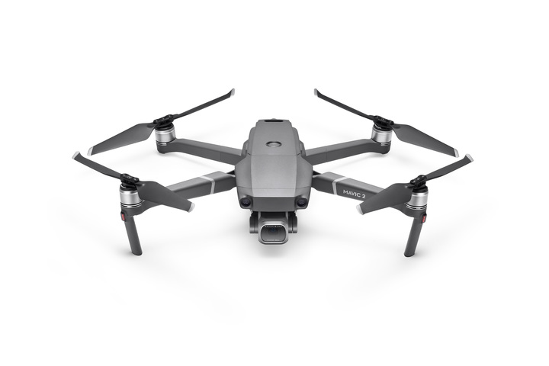
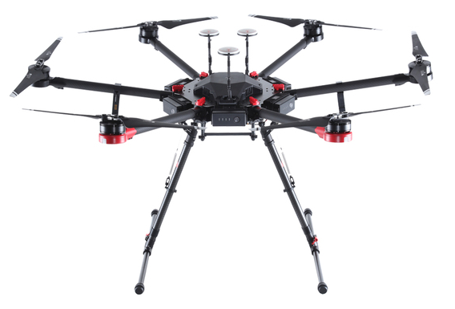
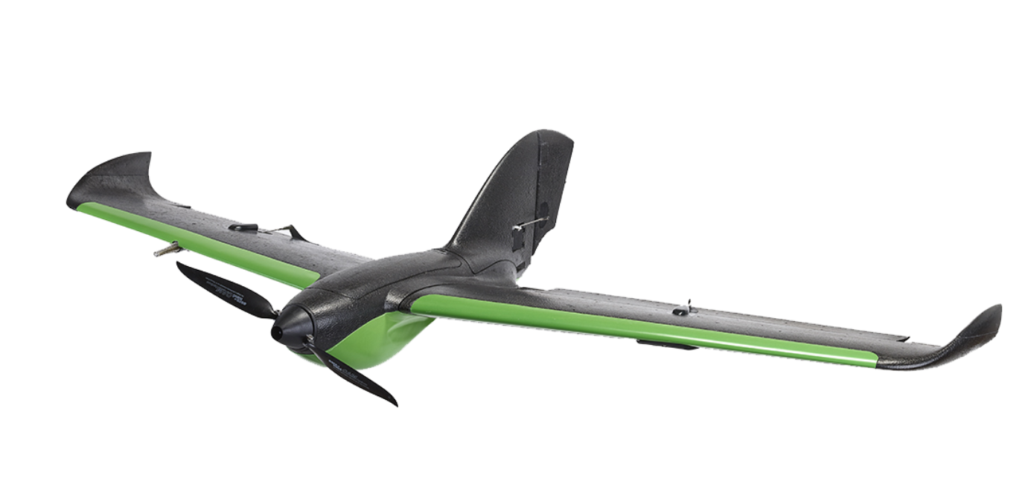
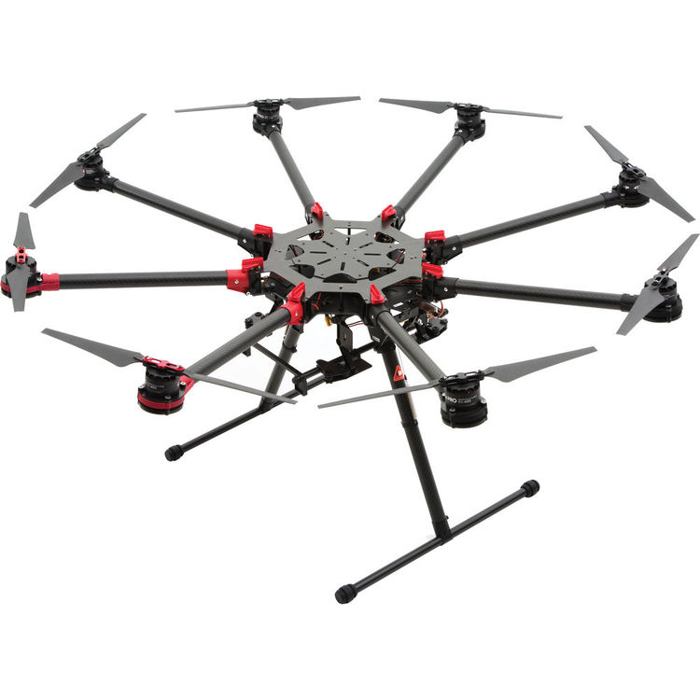
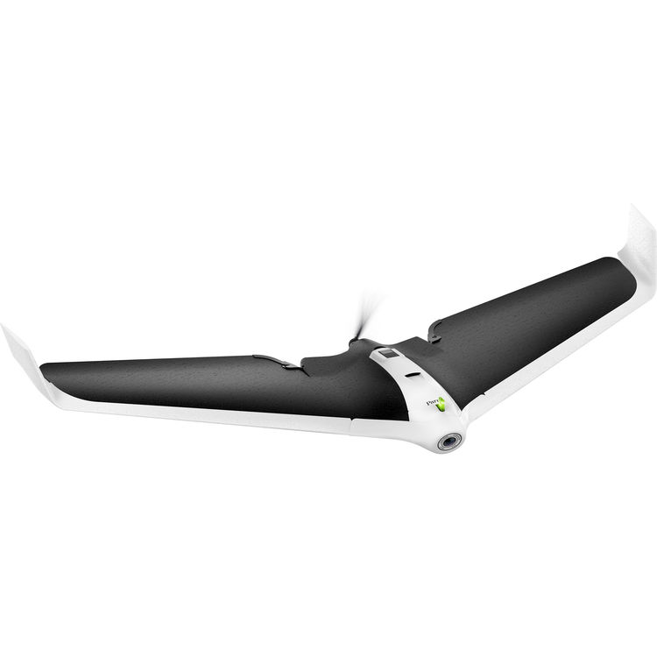
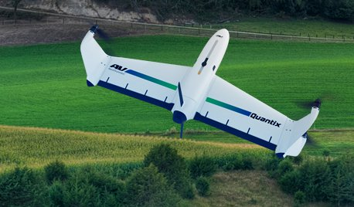
UAVs

Slide 5
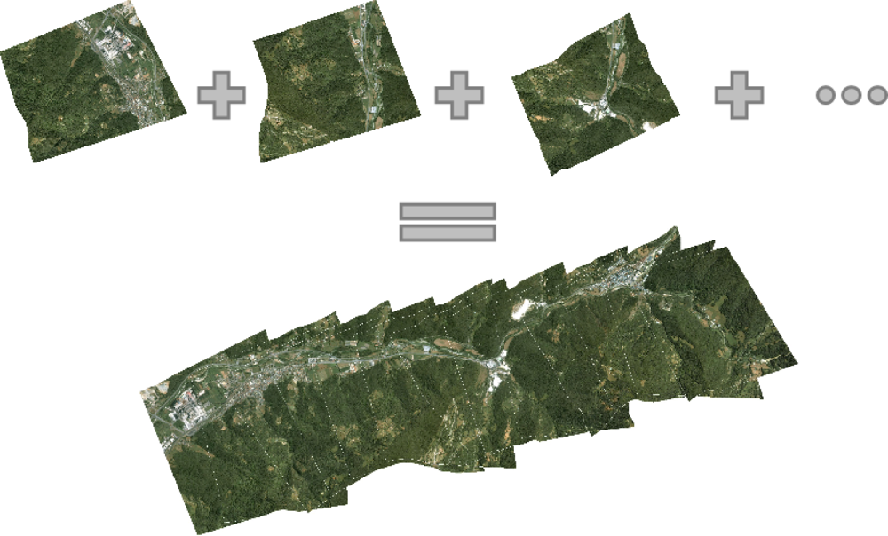
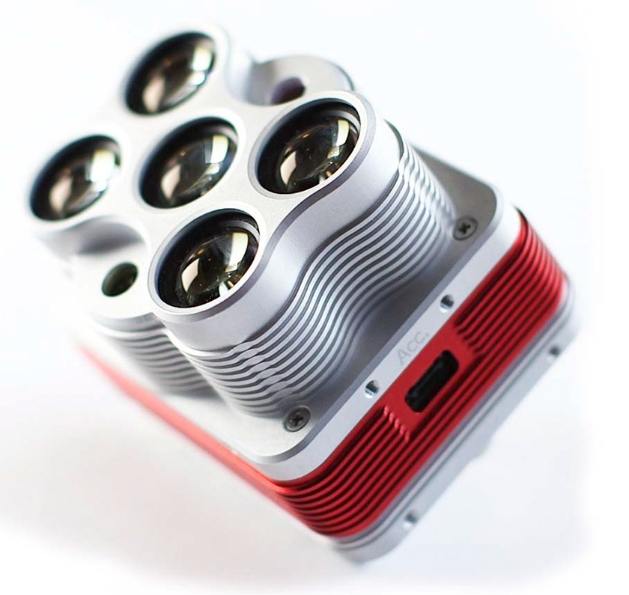
Multi-Spectral Imagery

Slide 6
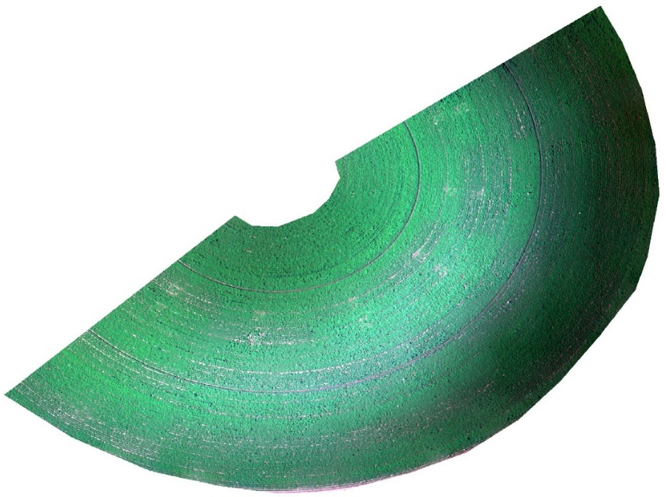
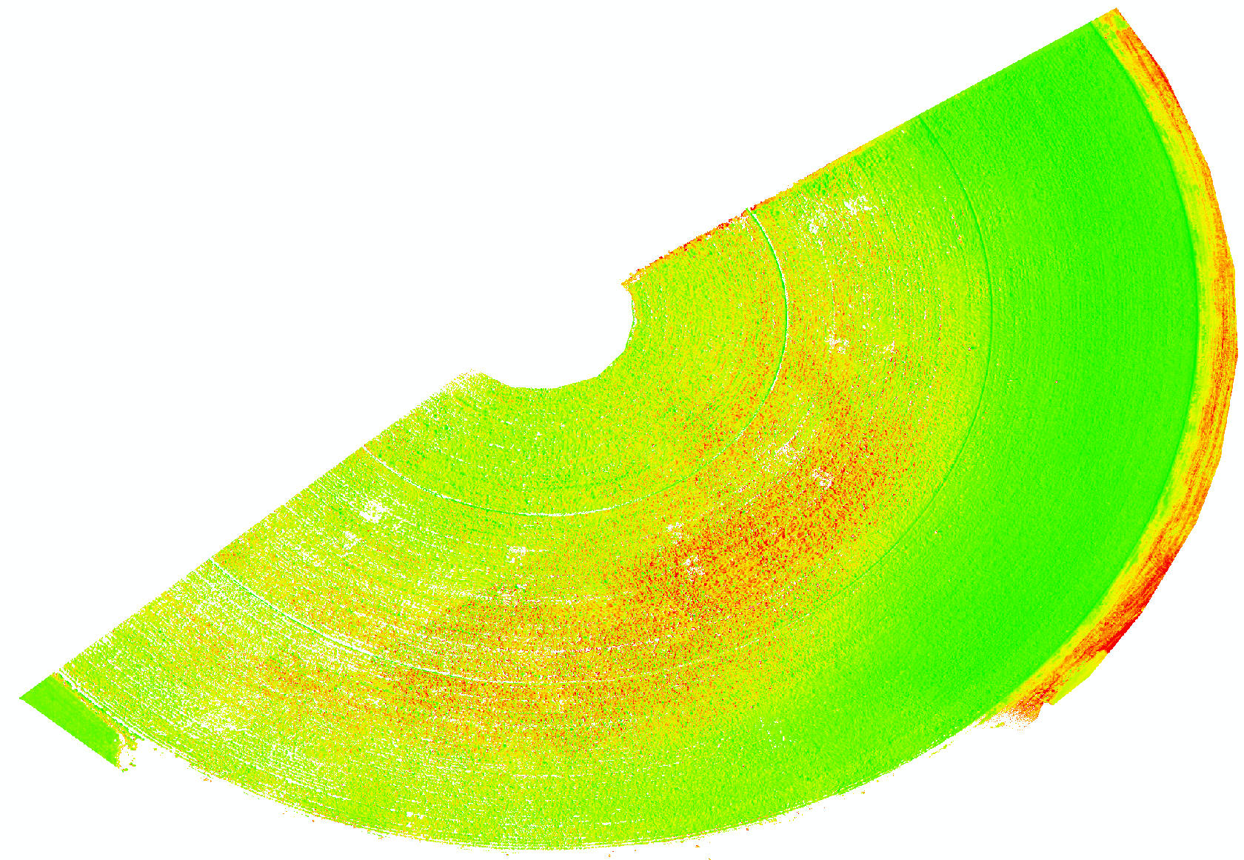
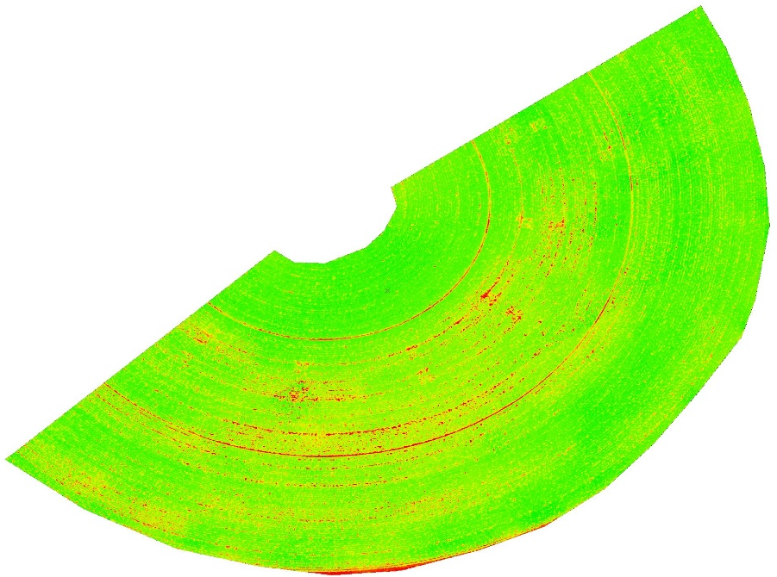
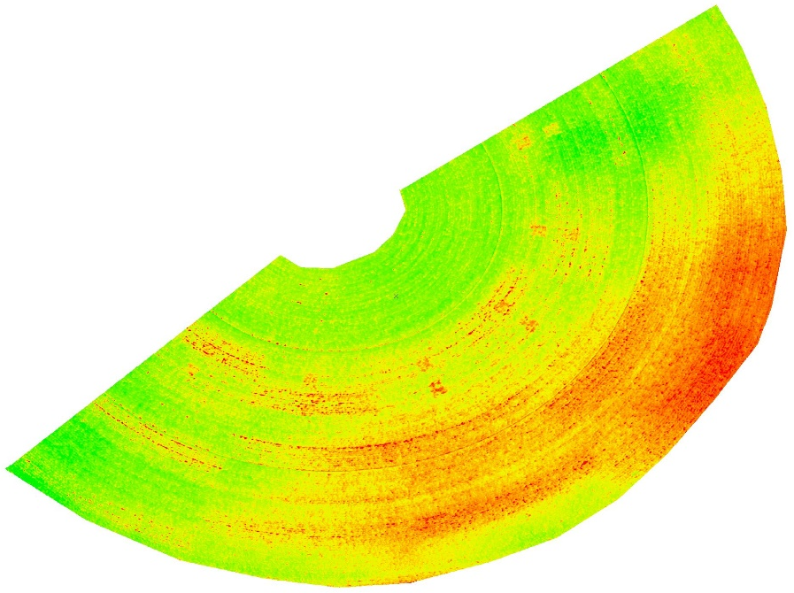
UAV Imagery
Visual
ET
Surface Temperature
NDVI

Slide 7
Developed new Program Objectives
Students will be able to assess a set of spatial phenomena relevant to agriculture or other human-environment interactions.
Students will be able to choose an effective set of decision tools for a current agricultural or environmental problem.
Students will be able to design a solution to an existing problem related to agriculture, the environment, or natural resources.

Slide 8
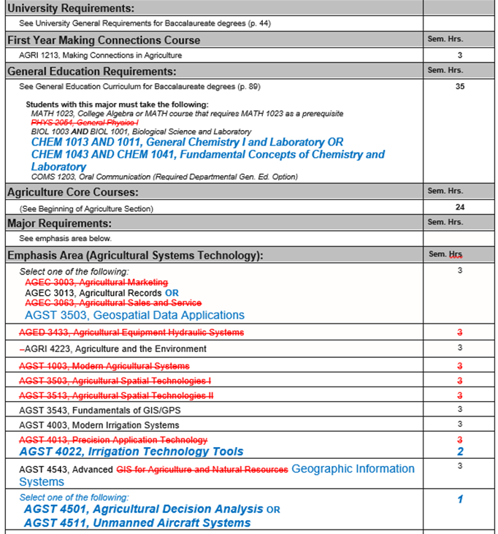

Slide 9
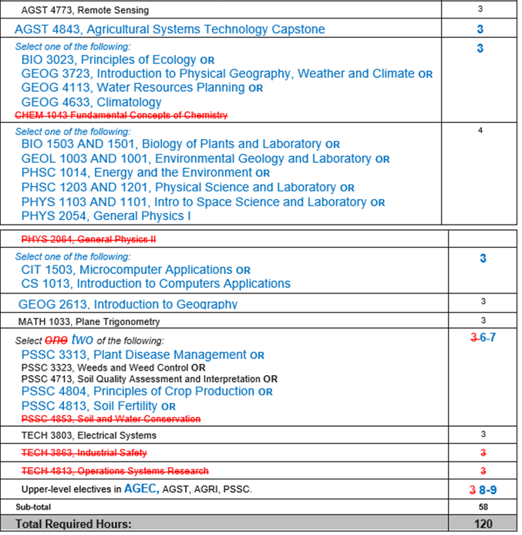

Slide 11
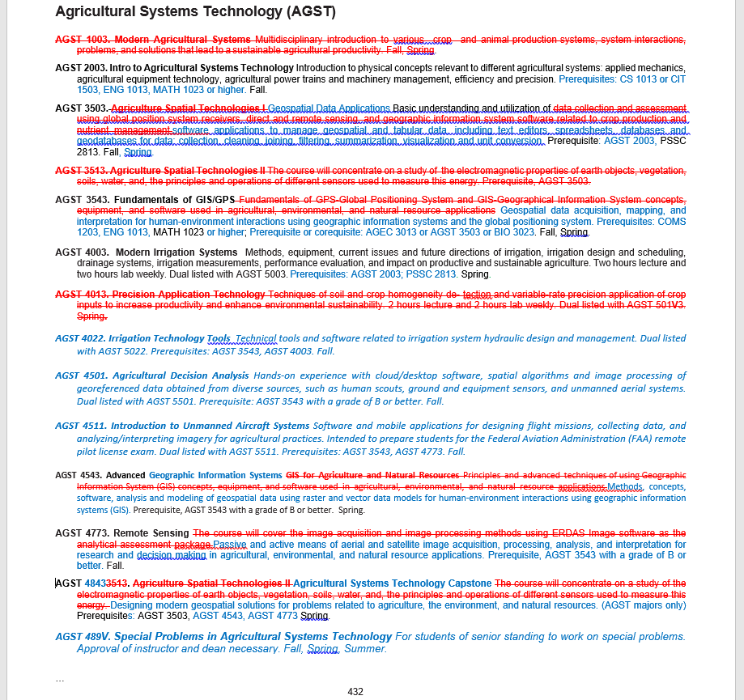

Slide 12
Thank you!
LEARN@STATE
AState.edu
/ArkansasState
@ArkansasState

